Slide 1
Implementation of
“Localizing Handle-Like Grasp Affordances
in 3D Point Clouds”
Team members: Jiatao Fan, Jordan Lee
Presentation date: 12/14/2015

Slide 2
Distribution of Tasks
Jiatao:
Survey into original paper and ROS source code
Implement quadratic surface fitting, estimating surface curvature, circle fitting on orthogonal plane and shell constructing
Testing and troubleshooting
Jordan:
Survey into original paper and ROS source code
Implement sampling and experiment data generation
Visualization for point cloud and experiment result
Testing and troubleshooting

Slide 3
General steps of implementation
Randomly sample N neighborhoods in the point cloud.

Slide 4
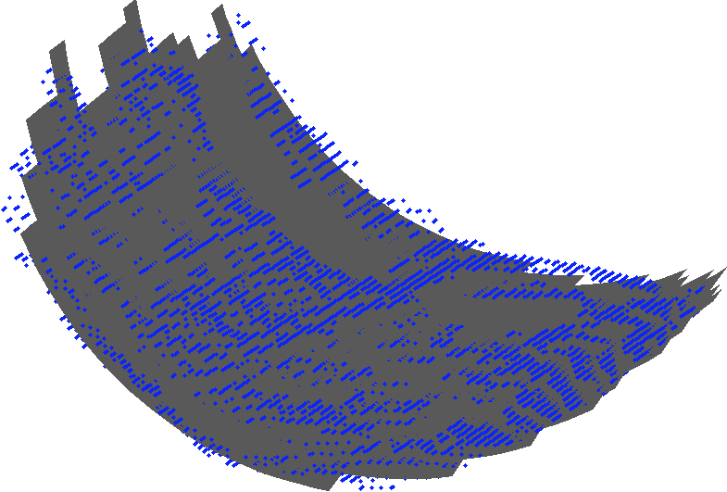
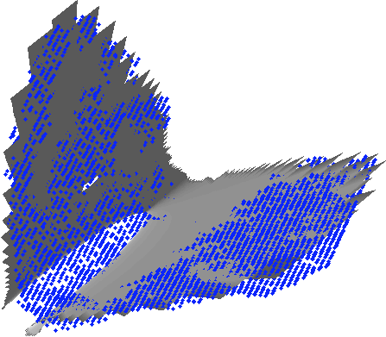
General steps of implementation
2. For each neighborhood, fit a quadratic surface to each of the neighborhoods.

Slide 5
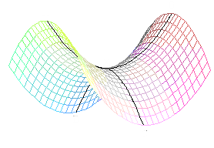
General steps of implementation
3. For each neighborhood, get the median curvature among all the maximum principal curvatures of each point. Use the corresponding normal and principal direction to calculate axis.
axis
normal
principal direction

Slide 6
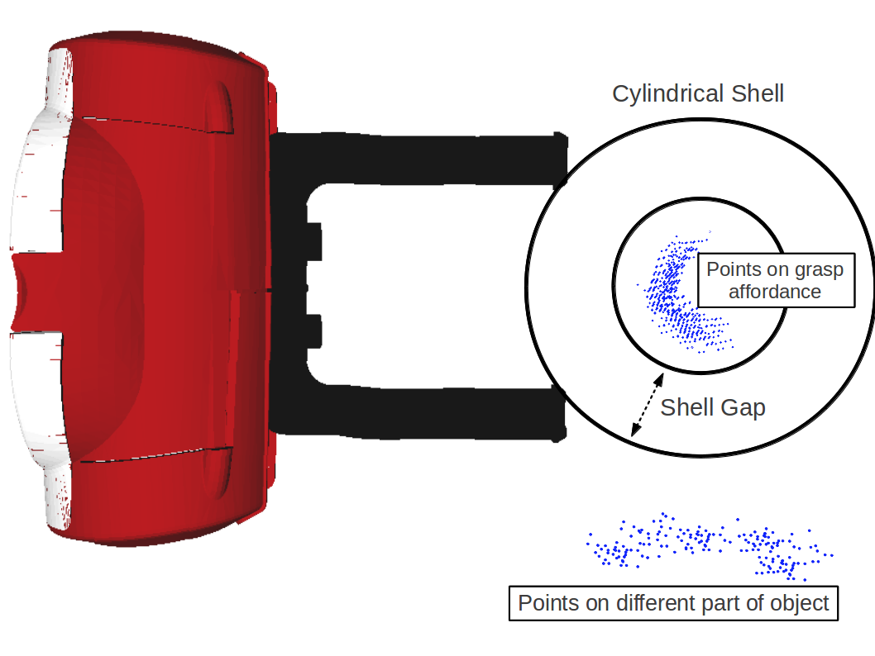
General steps of implementation
4. Filter out the neighborhood with median curvature below some threshold.
5. Project each neighborhood onto a plane orthogonal to the axis calculated in step 3. Fit a circle to points in plane.

Slide 7
General steps of implementation
6. Linear search for a gap between inner and outer shell of the cylindrical shell in order to let robot hand fit in.

Slide 8
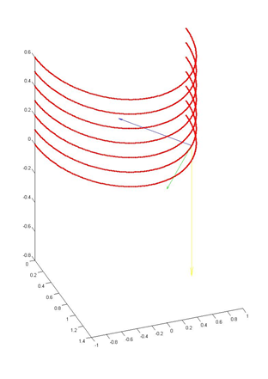
Algorithm Test Using Generated Points
- Half cylinder points
- Estimation of surface curvature
- Principal Direction

Slide 9
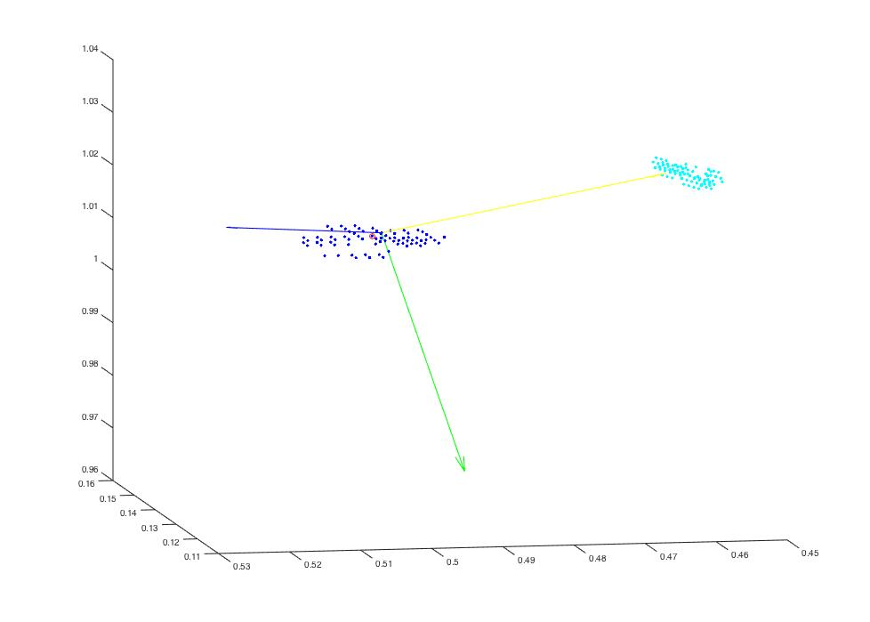
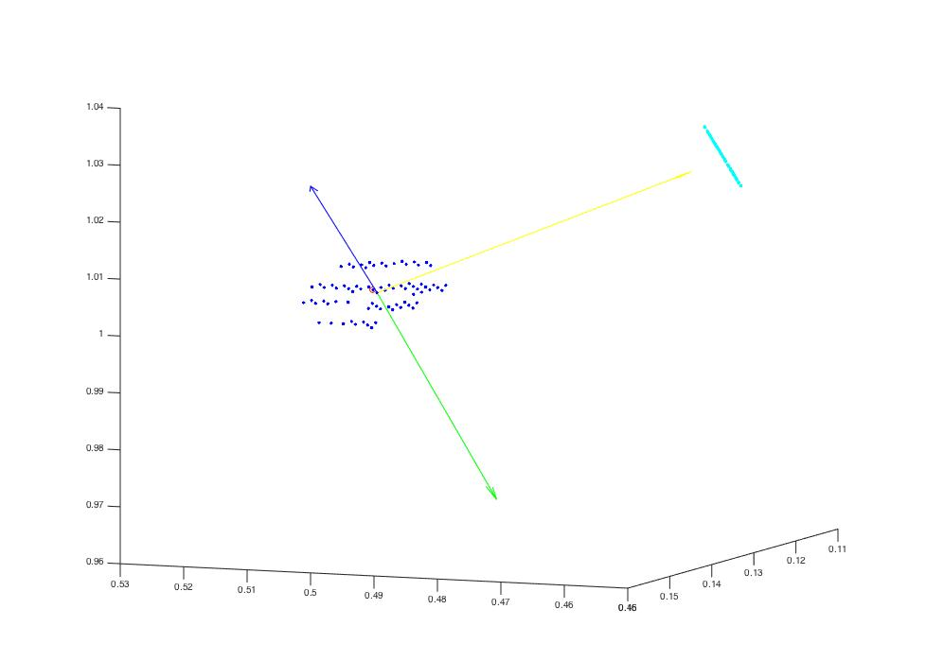
Using Point Cloud data
1.Select one neighborhood
2. Estimation of surface curvature
3. Project the points onto plane orthogonal to the minor principal axis

Slide 10
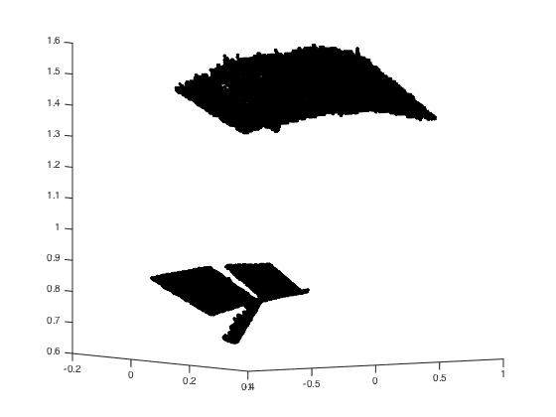
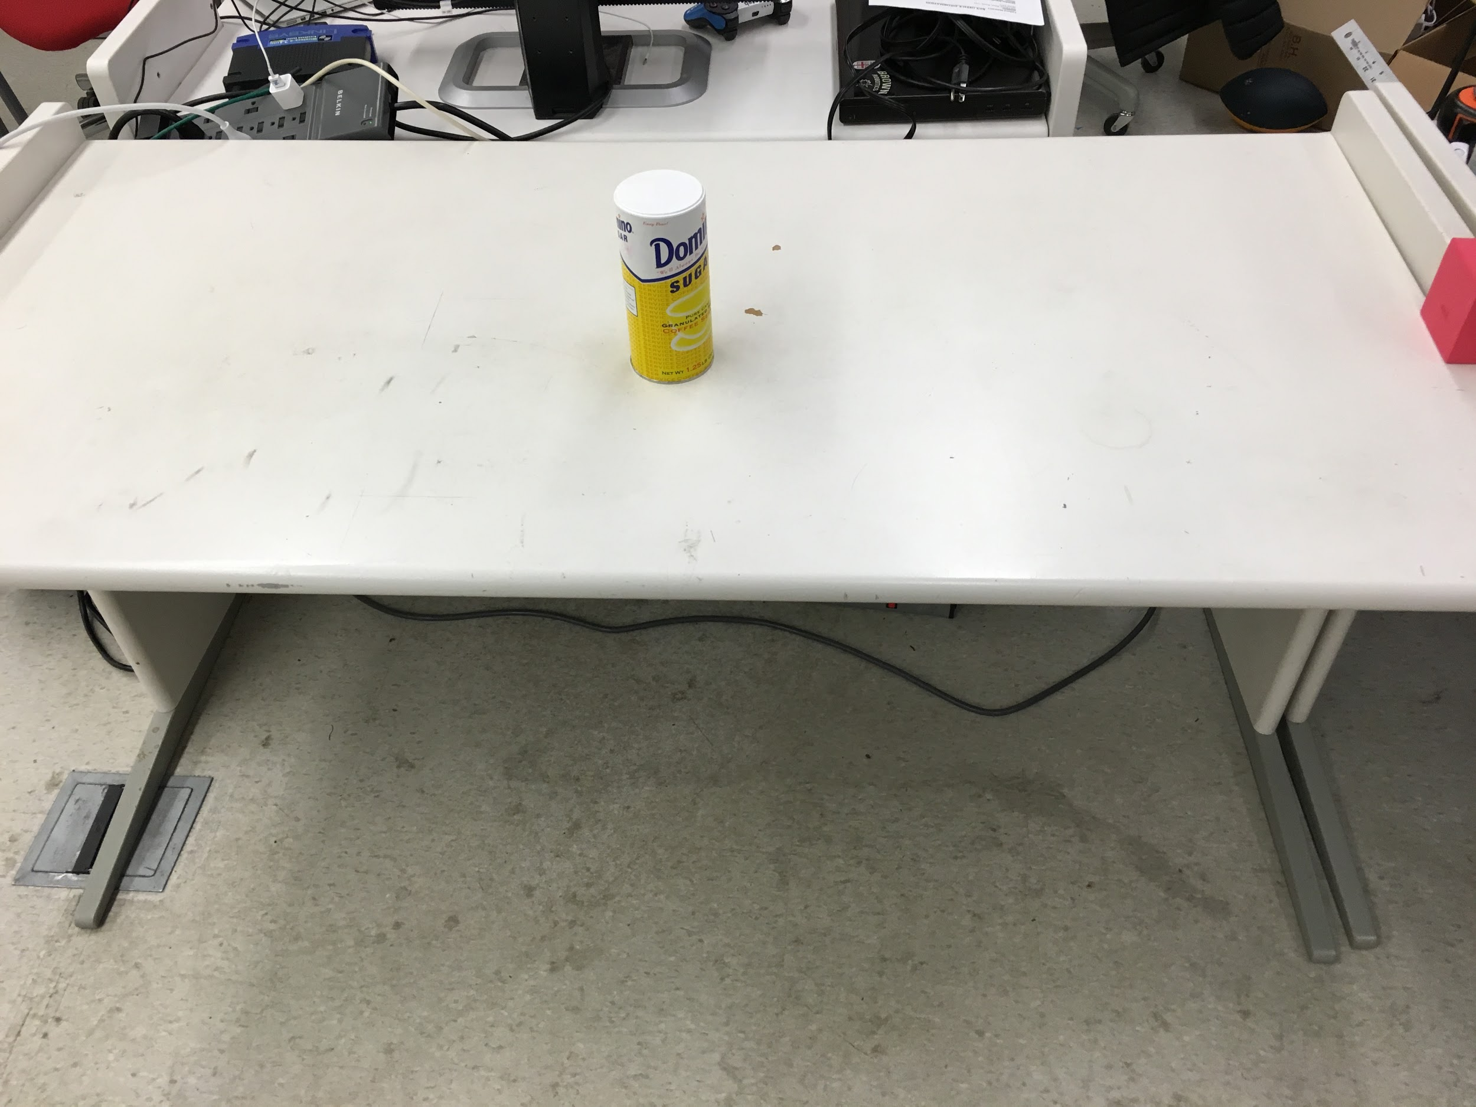
Applying to FETCH Robot
1.Point Cloud data from the Robot

Slide 11
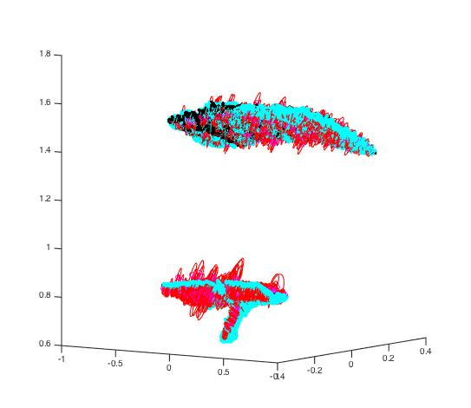
Applying to FETCH Robot
2.Point Cloud data from the Robot with randomly selected neighborhoods

Slide 12
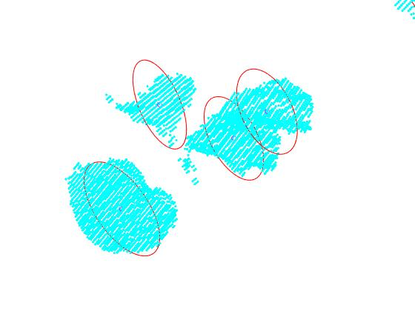
Applying to FETCH Robot
2.Point Cloud data from the Robot with randomly selected neighborhoods

Slide 13
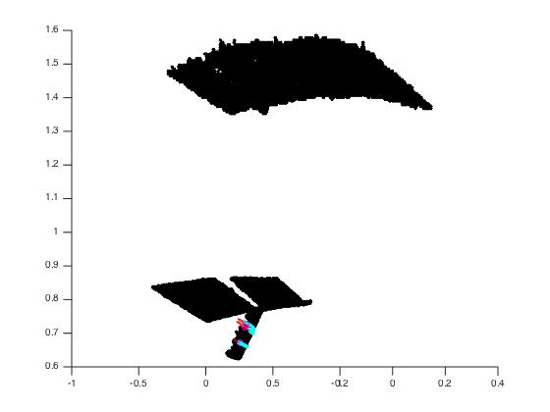
Applying to FETCH Robot
3.Point Cloud data from the Robot after applying curvature threshold
If curvature > K

Slide 14
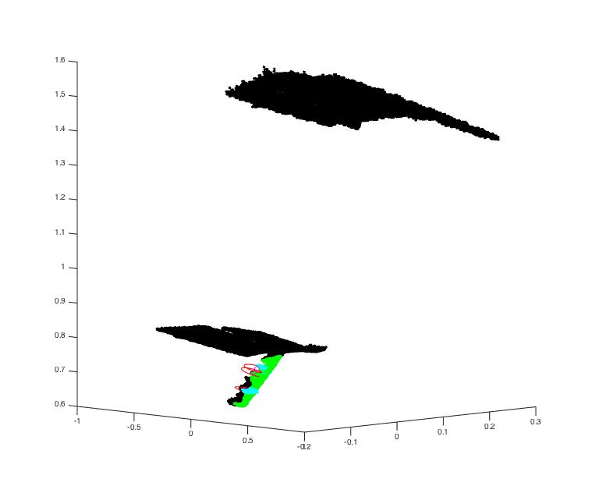
Applying to FETCH Robot
4.Point Cloud data from the Robot after applying handle search

Slide 15
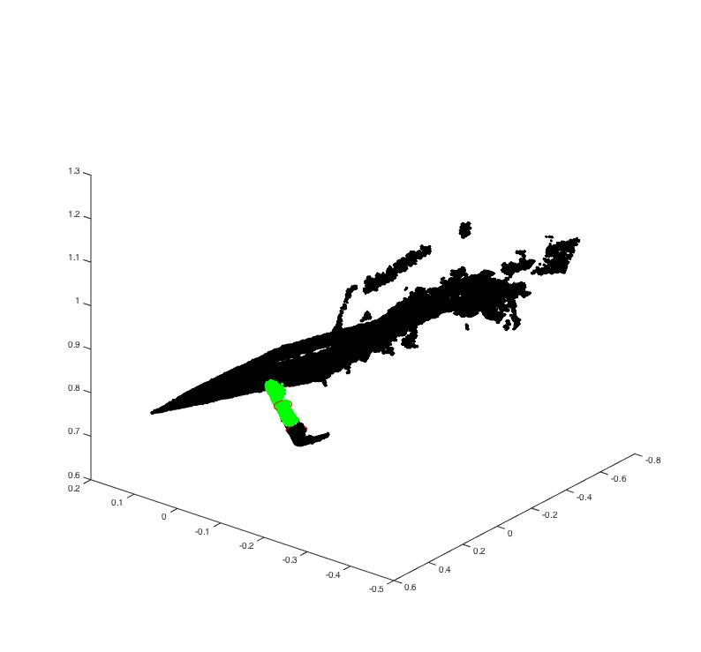
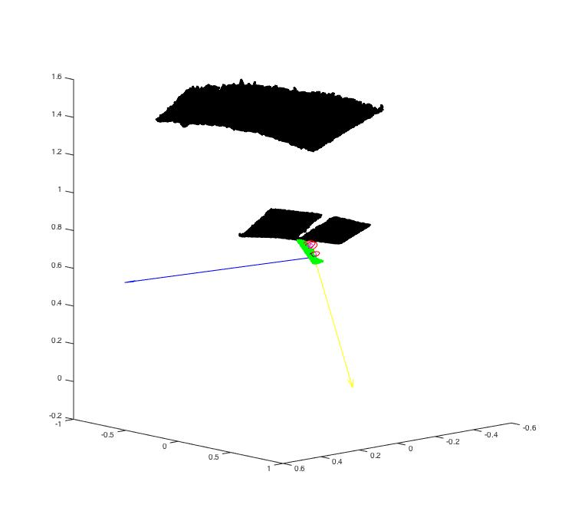
Applying to FETCH Robot
5. Send data(Normal, Principal Axis, Neighborhood point) to the Robot

Slide 16
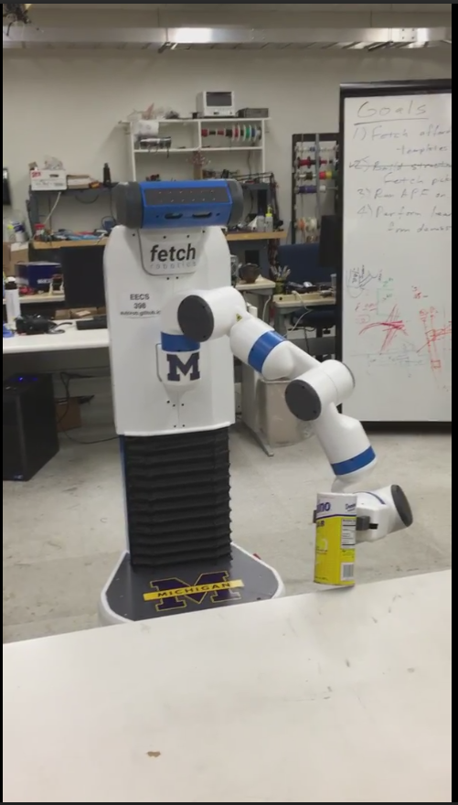
Applying to FETCH Robot
5. Send data(Normal, Principal Axis, Neighborhood point) to the Robot
Notes:
Why do we need principal axis for robot to grab?

Slide 17
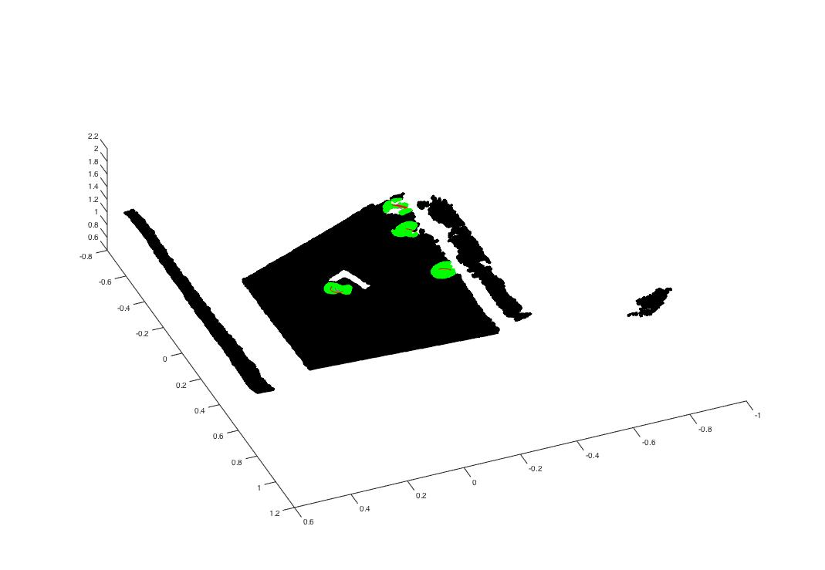
Applying to FETCH Robot
Future Works
-Other graspable points
-Normal Vector penetrates the desk
-Real time implementation
Notes:
Detect as graspable other than the object to grab.

